Slide 1


FACE DETECTION USING PYTHON AND OPEN CV

Slide 2

ABOUT FACE DETECTION
Face detection is a problem in computer vision of locating and localizing one or more faces in a photograph.
Locating a face in a photograph refers to finding the coordinate of the face in the image, whereas localization refers to demarcating the extent of the face, often via a bounding box around the face.

Slide 3
FACE DECTECTION WITH OPENCV
Feature-based face detection algorithms are fast and effective and have been used successfully for decades.
Perhaps the most successful example is a technique called cascade classifiers first described by Paul Viola and Michael Jones and their 2001 paper titled “Rapid Object Detection using a Boosted Cascade of Simple Features.”
In the paper, effective features are learned using the AdaBoost algorithm, although importantly, multiple models are organized into a hierarchy or “cascade.”
In the paper, the AdaBoost model is used to learn a range of very simple or weak features in each face, that together provide a robust classifier.

Slide 4
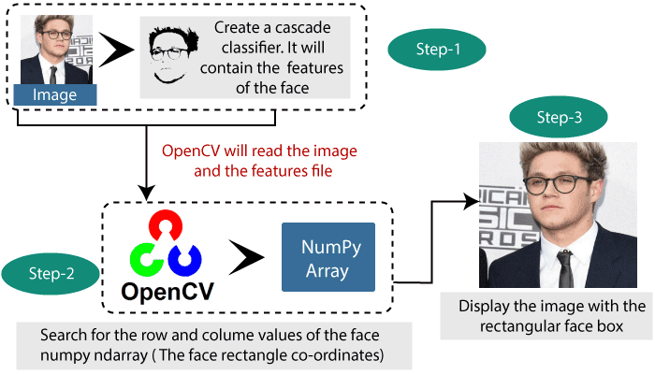

Slide 5


TEST PHOTOGRAPHS
We need test images for face detection in this tutorial. To keep things simple, we will use two test images: one with two faces, and one with many faces. We’re not trying to push the limits of face detection, just demonstrate how to perform face detection with normal front-on photographs of people.

Slide 6

FACE DETECTION ALGORITHM
A modern implementation of the Classifier Cascade face detection algorithm is provided in the OpenCV library. This is a C++ computer vision library that provides a python interface. The benefit of this implementation is that it provides pre-trained face detection models, and provides an interface to train a model on your own dataset.

Slide 7
PROCEDURE TO BUILD MODEL
Download a pre-trained model for frontal face detection from the OpenCV GitHub project and place it in your current working directory with the filename
Once loaded, the model can be used to perform face detection on a photograph by calling the detectMultiScale() function. This function will return a list of bounding boxes for all faces detected in the photograph.
The photo can be loaded using OpenCV via the imread() function.
Each box of the classifier lists the x and y coordinates for the bottom-left-hand-corner of the bounding box, as well as the width and the height.
Bounding boxes can be achieved by drawing a rectangle for each box directly over the pixels of the loaded image using the rectangle() function that takes two points.

Slide 8
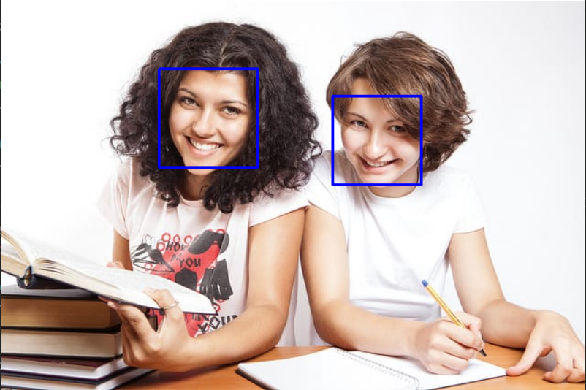
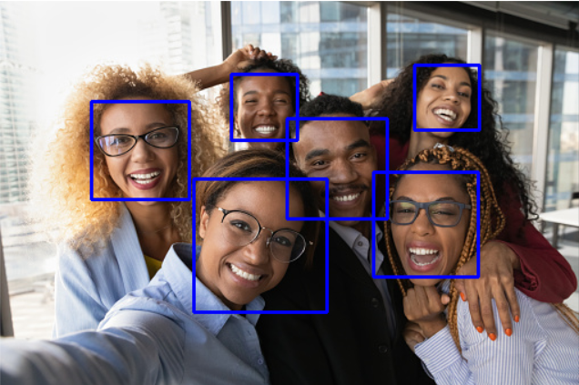
RESULTS OF TEST IMAGES

Slide 9
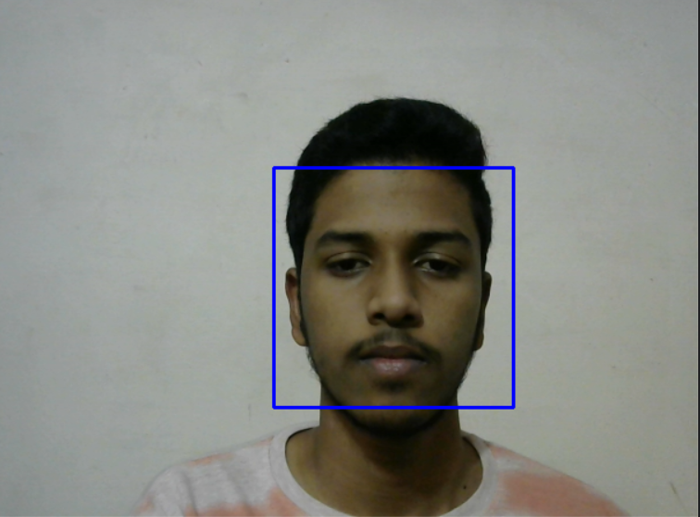
FACE DETECTION USING WEBCAM

Slide 10
THANK YOU
BY
20071A6712 – D. SIDDHARTH
20071A6713 – D. Neeraj ashish

